Slide 1
Liveability

Slide 2
Choose one of the three houses…
Looking at each of the pictures, choose the house that you would like to live in.

Slide 3
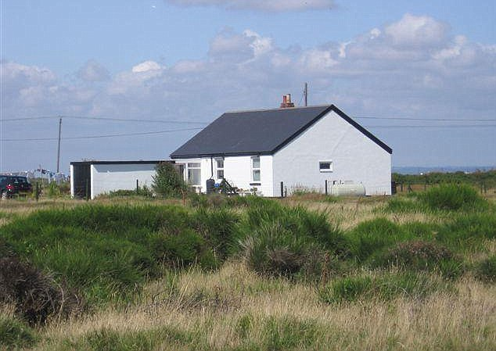

Slide 4
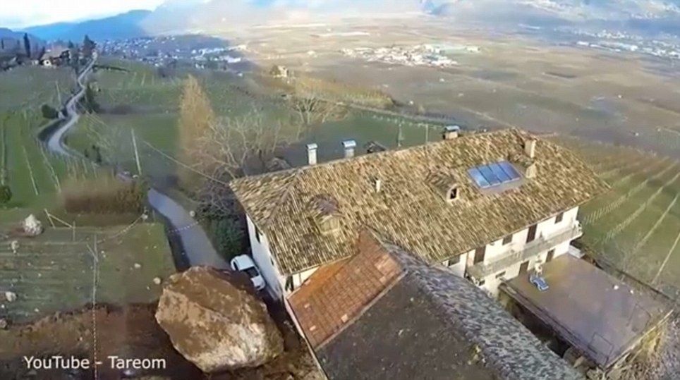

Slide 5
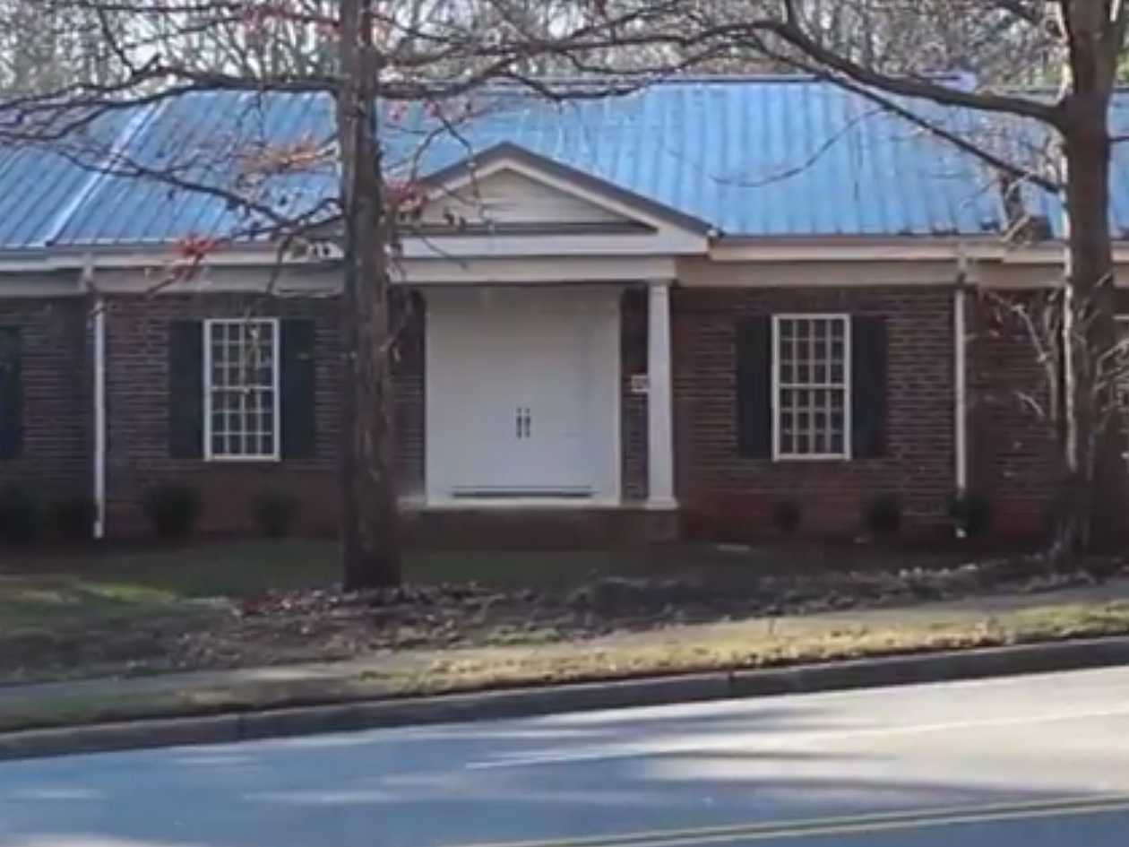

Slide 6
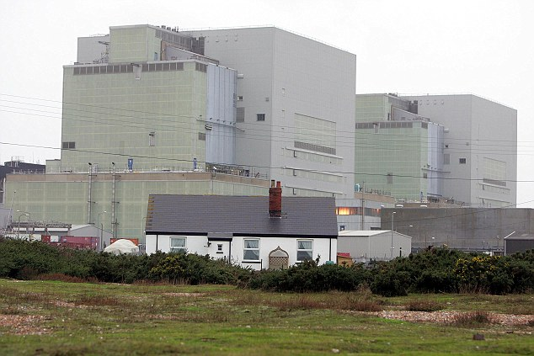

Slide 8
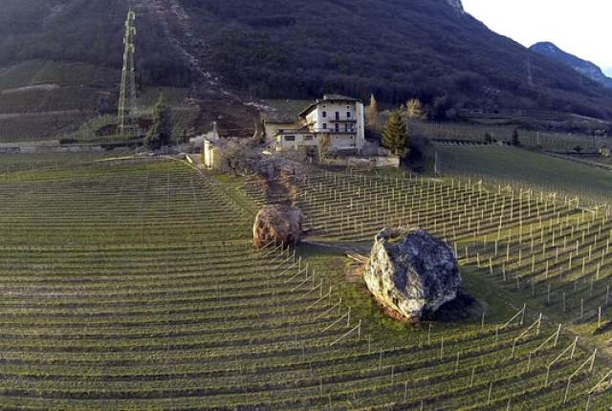
http://www.dailymail.co.uk/news/article-2547882/Watch-amazing-footage-destruction-wreaked-rockfall.html

Slide 9
The house on Wade Avenue
https://www.youtube.com/watch?v=QobxnFYhMos

Slide 10
Liveability is the sum of the factors that add up to a community’s quality of life — including the built and natural environments, economic prosperity, social stability and equity, educational opportunity, and cultural, entertainment and recreation possibilities.

Slide 11
Liveability is the sum of the factors that add up to a community’s quality of life — including the built and natural environments, economic prosperity, social stability and equity, educational opportunity, and cultural, entertainment and recreation possibilities.

Slide 12
Dissect the meaning of this definition
Pictionary! Draw a symbol that represents each of the factors that make up liveability.
Then write down a reason why these factors are important to a community’s quality of life.
Pick a place anywhere in the world that you could live… explain why!

